Slide 1


The Configuration Variables
for the Cluster Variation Method
with
Alianna J. Maren, Ph.D.
Visualizations
October 03, 2018

Slide 2
Overview:
Visualizing the Configuration Variables
for the Cluster Variation Method (Both 1-D and 2-D)
Visual depiction of how the configuration variables appear in both the 1-D and 2-D CVM grids
Needed to design object-oriented programming (OOP) approach to computing configuration variable distributions and thermodynamic properties in a CVM grid
Precursor to code design and documentation

Slide 3
Configuration Variables in the 1-D CVM

Slide 4
The 1-D CVM: Comprised of a Single Zigzag Chain
Showing the Configuration Variables x_{i}, y_{i}, w_{i}, and z_{i}
There are four different kinds of local configuration variables:
x_{i} – the fraction of nodes in their specific activation state
y_{i} – nearest-neighbors
w_{i} – next-nearest-neighbors
z_{i} - triplets
Total numbers of each kind:
x_{i} – two types: A or B (“on” or “off,” respectively)
y_{i} – three types: A-A, A-B (also B-A), and B-B (degeneracy = 2 for A-B / B-A
w_{i} – three types: A--A, A--B (also B--A), and B--B (degeneracy = 2 for A--B / B—A – these occur within the same row for the 1-D case
z_{i} – six types of triplets; two have degeneracies of two each – see next slide

Slide 5


1-D CVM with Two Instances of Base Pattern
Base pattern characteristics:
Requires eight nodes; four A and four B
Yields one instance of each of the different triplets (including the degenerate types)
Envelope configuration: wraparound horizontally only
Total number of triplets = number of units
Horizontal wrap-around; identical with leftmost units
Legend
Configuration Variable (Triplet) Values (Equiprobable when h = 1)
z₁ = 0.125
Z₁ = 2
z₂ = 0.125
Z₂ = 2
z_{2var} = 0.125
Z_{2 var} = 2
variant
z₃ = 0.125
Z₃= 2
Unit in state A
Unit in state B
A
A
A
B
A
A
A
B
B
A
A
A
Wrap-around unit in state A
Wrap-around unit in state B
B
z₆ = 0.125
Z₆= 2
B
z₅ = 0.125
Z₅ = 2
A
z₅ = 0.125
Z₅ = 2
variant
A
z₄ = 0.125
Z₄ = 2
B
B
B
A
B
B
B
B
z_{i} = fraction of triplets of type i; Z_{i} = total number of triplets of type i

Slide 6
Square-Grid-Node Representation vs.
Dot-Grid-Node Representation
for the Same Grid
1-D grid with
two repeats of base pattern
Typical grid representation – easy pattern visualization
Horizontal wrap-around; identical with leftmost units
Dot grid representation – easy to view configuration variables (y, w, and z)
Same pattern in dot-grid representation
Same horizontal wrap-around; identical with leftmost units
The wrap-around on the left-hand-side was useful for structured code

Slide 7
Configuration Variables in the 2-D CVM

Slide 8
2-D Configuration Variable Values when h = 1
Vertical wrap-around; identical with bottom row
Envelope configuration: wraparounds vertically and horizontally
Total number of triplets = 4*number of units
Horizontal wrap-around; identical with leftmost units
Legend
Configuration Variable (Triplet) Values Equiprobable when h = 1
z₁ = 0.125
Z₁ = 16
z₂ = 0.125
Z₂ = 16
z_{2var} = 0.125
Z_{2 var} = 16
variant
z₃ = 0.125
Z₃= 16
Unit in state A
Unit in state B
A
A
A
B
A
A
A
B
B
A
A
A
Wrap-around unit in state A
Wrap-around unit in state B
B
z₆ = 0.125
Z₆= 16
B
z₅ = 0.125
Z₅ = 16
A
z₅ = 0.125
Z₅ = 16
variant
A
z₄ = 0.125
Z₄ = 16
B
B
B
A
B
B
B
B
z_{i} = fraction of triplets of type i; Z_{i} = total number of triplets of type i

Slide 9
Two Different Visualizations of the Same 2-D CVM Grid
Block grid:
Used in most papers & slidedecks
Easiest for visualizing local shapes & patterns
Dot grid:
Used only to show how the different configuration variables are set up
Note: BOTH grid patterns show both horizontal and vertical wrap-arounds; at the top and right-side edges; dark and light mottled grey

Slide 10
The y_{i} Configuration Variables in a 2-D CVM Grid
Four y_{i} nearest-neighbor variables are diagonally UP or DOWN with regard to the center node
Col 0
Col 1
Col 2
Col 3
Col 4
Four y_{i} nearest-neighbor variables:
Row 0
One on each diagonal
Separation distance = 1 unit
Divide by 2 to account for degeneracy in counting
Total of 2N Y config variables for a grid, where N = number of nodes, and Y = total number of nearest-neighbor connections
Row 1
y_{i}:
Row 2
Row 3
Row 4

Slide 11
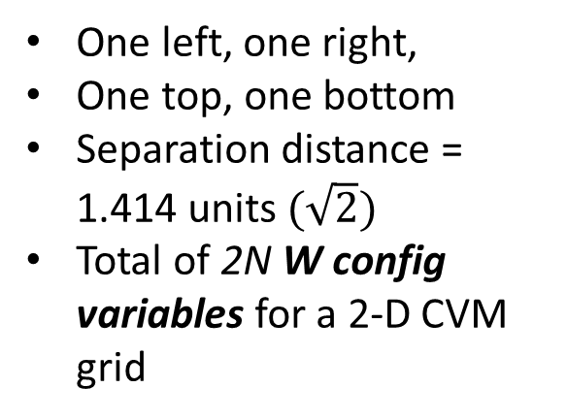
The w_{i} Configuration Variables in a 2-D CVM Grid
Four w_{i} nearest-neighbor variables are the two horizontal and two vertical neighbors
Col 0
Col 1
Col 2
Col 3
Col 4
Row 0
Four w_{i} next-nearest-neighbor variables:
Row 1
One left, one right,
One top, one bottom
Separation distance = 1.414 units $(\sqrt{2})$
Total of 2N W config variables for a 2-D CVM grid
w_{i}:
Row 2
Row 3
Row 4

Slide 12
The Eight z_{i} Configuration Variables per Node in a 2-D CVM Grid
Four horizontal z_{i} configurations
Within two rows and three columns each:
Four z_{i} triplet variables within the rows immediately above and below the central node
Four vertical z_{i} configurations
Within two columns and three rows each:
Four z_{i} triplet variables extend to two rows above and two rows below the central node (two for each direction)

Slide 13
These are NOT z_{i} Configurations
NOT allowable z_{i} configurations:
The z_{i} triplet variables must be in a “bent-angle” configuration, not a straight line.

Slide 14
For More Information:
GitHub Public Repository:
https://github.com/ajmaren/2D-Cluster-Variation-Method
Website:
www.aliannajmaren.com
Code Availability:
Code will be made available on the public GitHub repository after initial development, documentation, V&V, and experiments are completed.
Look on arXiv for various papers documenting theoretical and experimental results. See the “Patents and Publications” page on www.aliannajmaren.com for full access to the latest papers. See the “Blog” page for discussions on theory, code, and experimental results.
Contact Information:
Alianna J. Maren, Ph.D.:
alianna@aliannajmaren.com
alianna.maren@northwestern.edu

